Slide 1
Energy

Slide 2
Energy is measured in?
Joules
Remember that 1kJ =1000J
So what does 3.5kJ equal?
How many kJ = 2500J

Slide 3
Energy is:
The ability to do work

Slide 4
Kinetic Energy
Kinetic energy is the energy of a moving object
It’s Formula is E_{k}= 0.5mv²
^{IMPORTANT} ^{mass=kg} v= m/s

Slide 5
https://www.youtube.com/watch?v=g_DBLppDZAs
The cop car has a velocity of 30.5 m/s and weighs 1500kgs.
What is it’s kinetic energy?

Slide 6
A go Kart is going 10.5m/s and weighs 35.5kgs. Work out its Kinetic Energy

Slide 7
Potential Energy
Is energy that an object has because of it’s position or it’s structure
E.g Chemical energy in foods and explosives contain energy in their chemical bonds

Slide 8
Calculating Gravitational Potential Energy
Formula
E_{P} = mgh
M= mass (kgs)
G= gravity (constant of 9.8m/s²)
H= height (m)

Slide 9
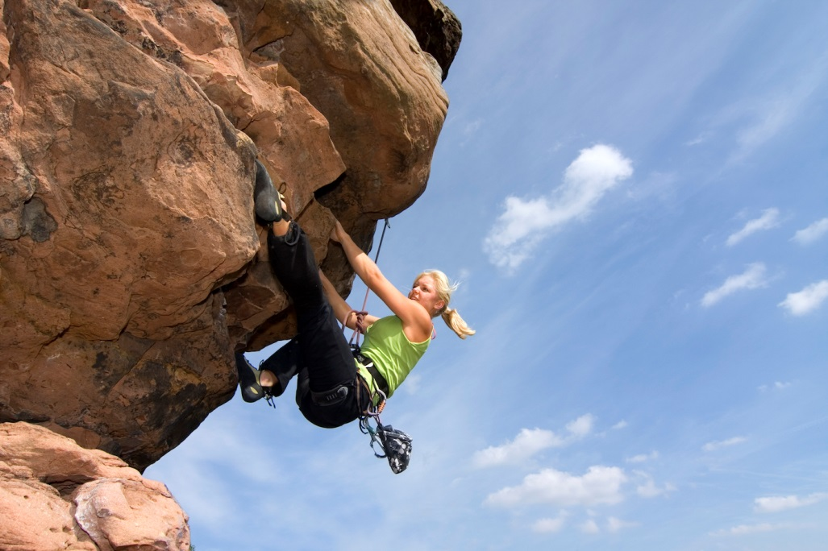
Example 1
This rock climber has a mass of 50kgs. She has climbed 35 meters off the ground. A) What is here Gravitational Potential Energy at that point in her climb
B What is it at the start of her climb (0m)

Slide 10
Example 2
A boulder is on the edge of a cliff. It weighs 1000kgs. It is 20m high. What is it’s GPE?

Slide 11
Conservation of Energy
Energy may be transferred but never created nor destroyed.
The amount of energy at the start = the amount of energy at the end
E_{t}= E_{p}+E_{k}

Slide 12
Example 1
A tennis ball dropped from a height only has GPE
As it falls GPE decreases and KE increases and the ball speeds up
Just before the ball hits the ground all of the energy is converted into kinetic energy

Slide 13


Example 1 continued
All Potential Energy
½ PE and ½ KE
All KE just before hitting ground

Slide 14
Worked Example
A 0.5kg tennis ball is dropped from a height of 3 meters:
A)Calculate it’s GPE when released
B) Total Energy when released
C) Kinetic Energy halfway down
D) Kinetic Energy when it hits the ground

Slide 15
A) GPE when released
M=0.5kg g=9.8 h=3m
GPE=mgh
0.5 x 9.8 x 3
=14.7J

Slide 16
B) Total Energy When Released
When released the ball has no kinetic energy, so the total energy is 14.7J

Slide 17
Kinetic halfway down
Halfway down the ball has a height of 1.5m and has GPE
GPE = mgh
GPE= 0.5 x 9.8 x 1.5
Total energy is 14.7 so the kinetic must be 14.7-7.35
=7.35J
The kinetic and GPE are the same at the halfway point

Slide 18
Kinetic as it hits ground
When it reaches the ground there is no GPE so the KE is 14.7J

Slide 19
Energy Efficiency
Pearson 10 page 283: Top right hand side
Give a brief sentence describing what energy efficiency is
Give the formula

Slide 20
Energy Efficiency
Can something be 100% energy efficient?
Why or why not?

Slide 21
Work
Work is the total amount of energy used. The formula for work done is:
WD= F x d
Work done (J) = Force x Distance

Slide 22
Worked example
A person pushes a box with 5000N of force. It moves a distance of 10m. How much work has been done on the box?
Step 1 Write the equation
WD= F x d
Step 2 Write the values in
F = 5000N
D= 10m
Step 3: Solve
5000 x 10 = 50 000
Step 4 Check your units
J

Slide 23
Your turn
A car applies friction force to its brakes. It takes 10,000N of force to stop and stopped after 30m.

Slide 24
New example
There is 500 J of work done when moving a fridge into it’s new position. It was moved 10 meters from it’s original position. How much force was needed to move it?
Step 1. Set out your formula
WD= F x D

Slide 25
Re-arranging Equations
Step 2: Write down what you know:
WD= F x D
WD= 500J
F= ?
D = 10m
Put into formula
500J= F x 10

Slide 26
Re-arranging Equations
500J = F x 10
Re arrange equation so you get F by itself
To do this you need to get rid of the 10 on the right side
To do that you need to divide the 10 by 10 on the right and the left so it will look like this:
500 = F
10

Slide 27
Re-arranging Equations
500/10=F
F= 50N

Slide 28
Re-arranging equations
A bat gets thrown 12 meters. The amount of work it did before landing was 250J

